Slide 1


Sales and Production Analysis Report…

Slide 2
About the Company
Manolaya International Inc is an Indian-based company with headquarters in Chennai, Tamil Nadu.
They are involved as the supplier, exporter of Natural products like Cup sambrani, Agarbathi, flower cups components.
The company deals with the manufacturer for representing their products in India which requires local market knowledge and countrywide reach.

Slide 3




Project Description

Slide 4
Sales Analysis…
Conducted in-depth analysis of sales data, identifying trends, patterns, and areas of opportunity for different product categories.

Slide 5
Production Analysis…
Production Analysis involved evaluating and extracting insights from production-related data to optimize operational efficiency and drive improvements.

Slide 6
Sales And Production Forecasting…
The process of predicting future sales volumes, customer demand, and production requirements based on historical data, market trends, and other relevant factors.

Slide 7
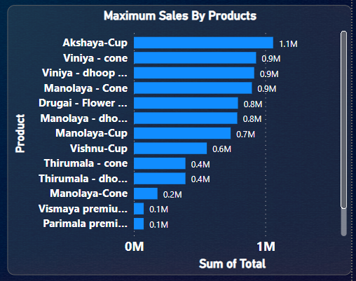
Problem Statements…
1. Identifying product categories with increasing sales in Manolaya International Inc.

Slide 8
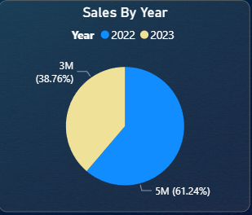
Problem Statements…
1. Identifying product categories with increasing sales in Manolaya International Inc.
2. Analyzing sales performance for Manolaya products

Slide 9
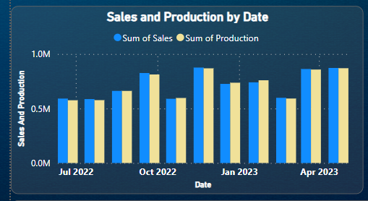
Problem Statements…
2. Analyzing sales performance for Manolaya products
3. Comparing sales and production in Manolaya International Inc.

Slide 10
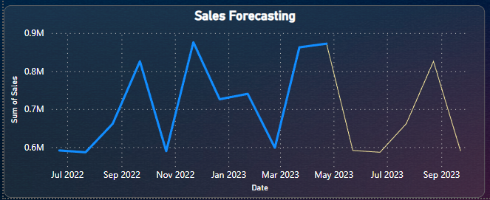
Problem Statements…
3. Comparing sales and production in Manolaya International Inc.
4. Predicting the future sales using forecasting.

Slide 11
Problem Statements…
4. Predicting the future sales using forecasting.

Slide 12
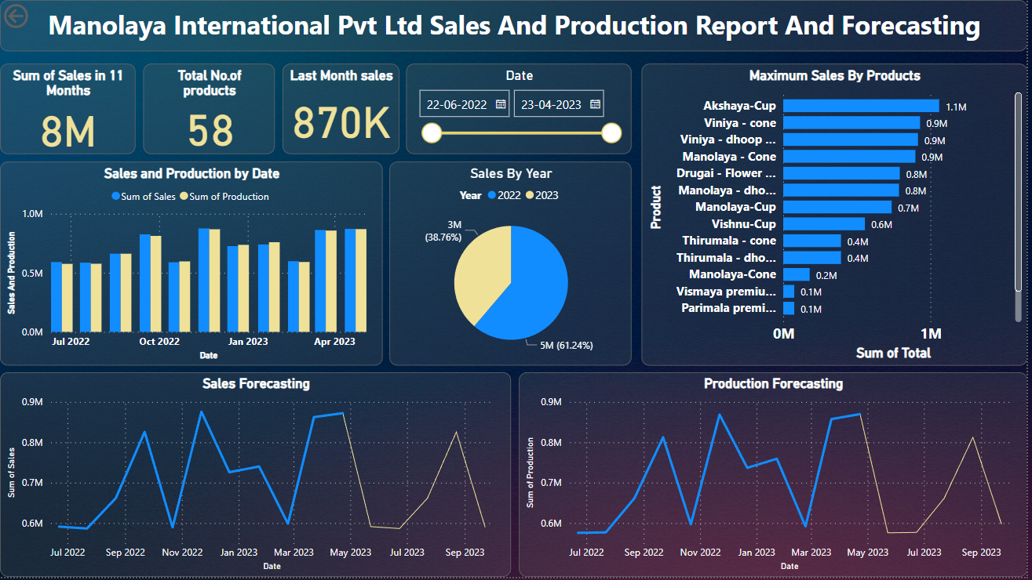
overall report

Slide 13
Thank you

